Slide 1
Module 1
Project management
Part 7

Slide 2

Execution process group (most part of the project team)
Group functions:
Coordination of people and resources
Integration and execution of project operations in accordance with the project management plan

Slide 3
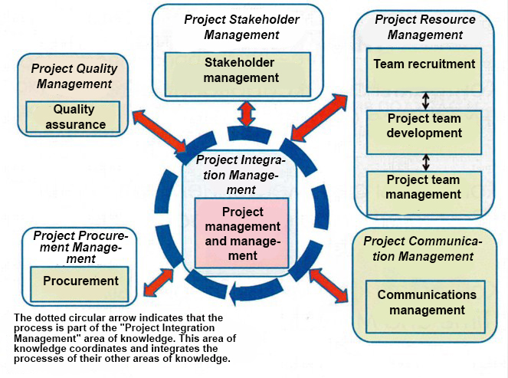

Slide 4
Corrective action is an intentional action that aligns the execution of the project with the project management plan.
The preventive action is an intentional action that ensures that the future execution of the work is consistent with the project management plan.
Defect repair is an intentional action to correct a product or component mismatch.

Slide 5
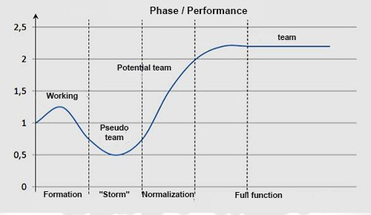
Team building stages

Slide 6


Slide 7
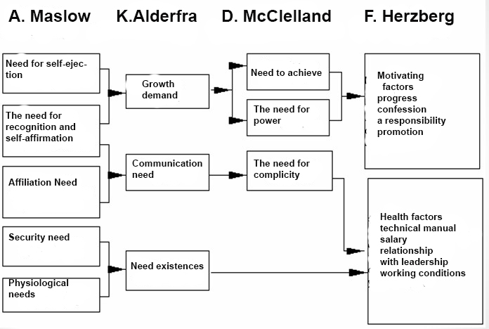

Slide 8
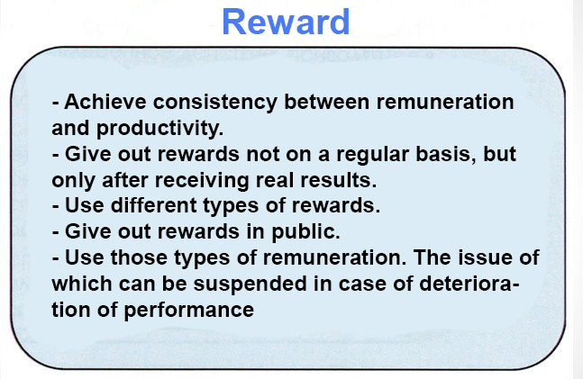

Slide 9

Conflict Resolution

Slide 10
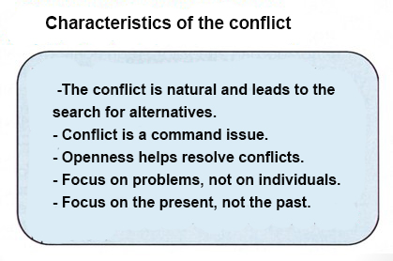

Slide 11
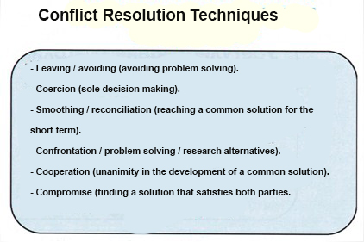

Slide 12
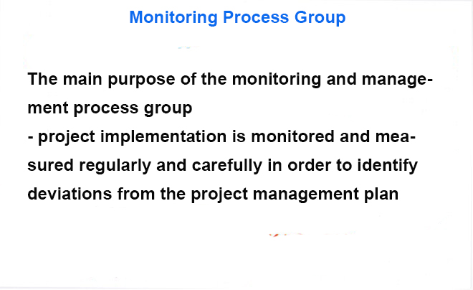

Slide 13
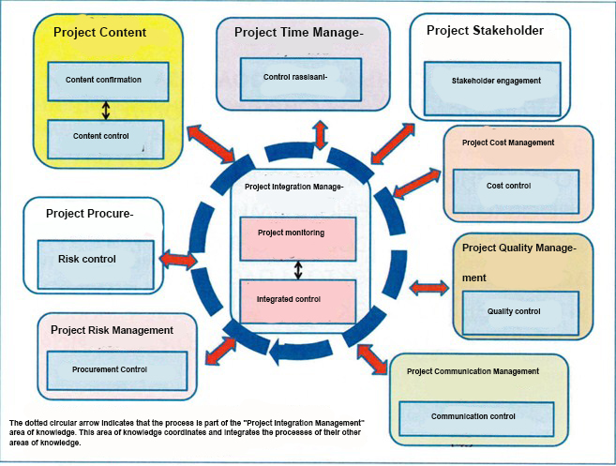

Slide 14
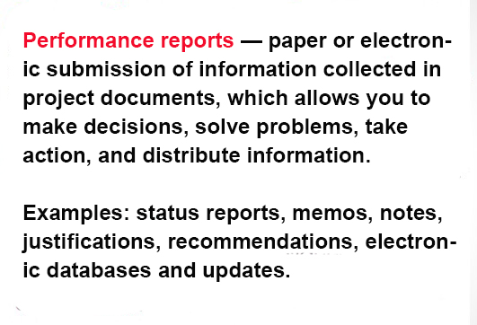

Slide 15
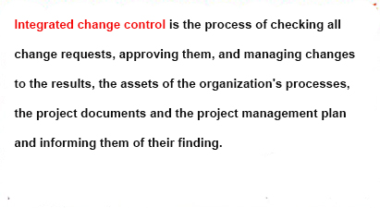

Slide 16
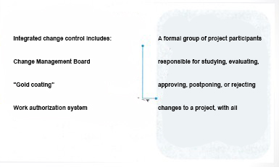

Slide 17
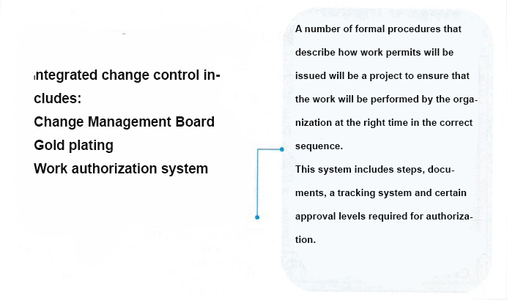

Slide 18

Performance Analysis? (Performance Reviews)
Variance analysis
Trend Analysis
Fulfillment of utilized volume

Slide 19
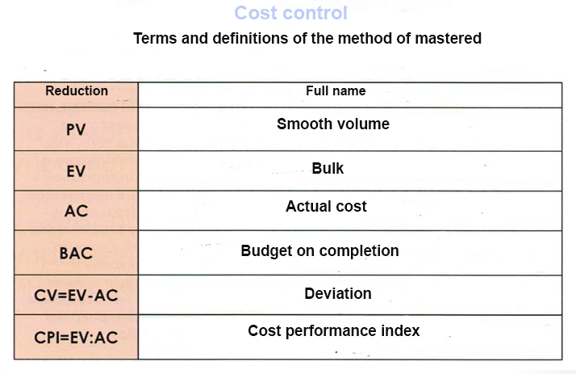

Slide 20
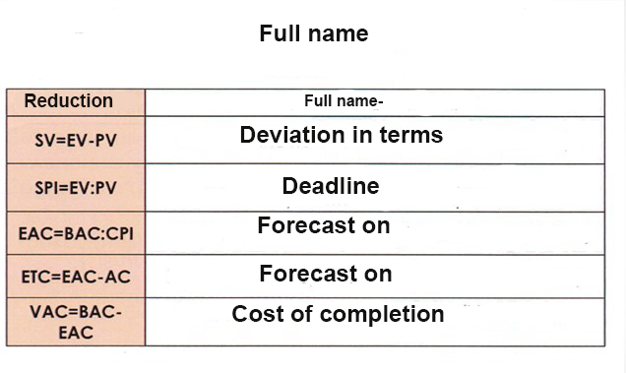

Slide 21
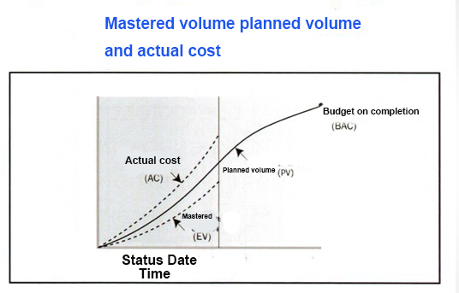

Slide 22
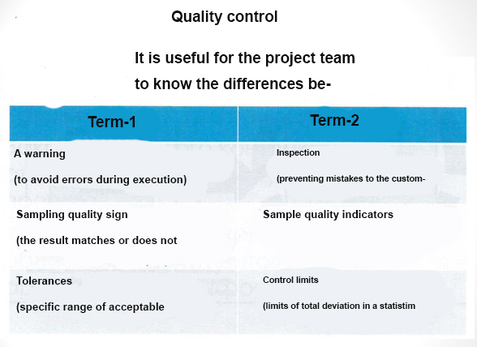

Slide 23
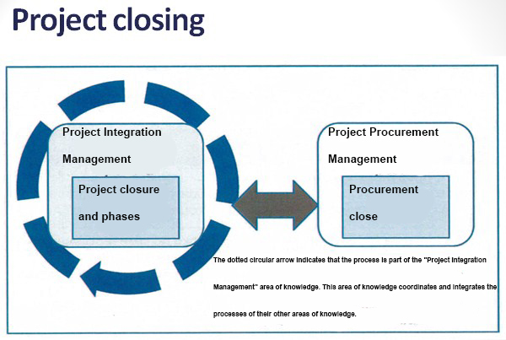

Slide 24

Types of project closure
Continuation
Starvation
Integration
Disappearance

Slide 25

Procurement close
Closing all project purchases
Closing of each contract related to the project or its phase
Resolve open claims, update documents and archive information

Slide 26
Application -
Analysis of project performance
Project - Fence Construction
(outside - the plan, inside - what is done)
1 day / 1000$
100% / 1000$
1 day
1000$
0%
1 day
1000$
100%
1200$
50% / 600$
1 day / 1000$

Slide 27
Notation | Name | Payment | Comment
PV | Planned volume | 3000$
EV | Mastered volume | 100% + 100% + 50% 1000$+1000$+500$=2500$
AC | Actual cost | 2800$
BAC | Completion budget | 4000$
CV = EV-AC | Deviation from cost | 2500$ - 2800$ = -300$
CV% = CV/EV | Deviation from cost% | -300/2500*100% = -12%
CPI = EV/AC | Cost performance index | 2500/2800=0,89 | ˂1 - costs are ineffective ˃1 - vice versa
SV = EV-PV | Deviation in terms | 2500$ - 3000$ = -500$
SV% = SV/PV | Deviation in terms of% | 500/3000 * 100% = -16%

Slide 28
Notation | Name | Payment | Comment
SPI = EV/PV | Deadline | 2500/300=0,84 = 84% | ˂1 – ПЛОХО 8h / shift * 0.84 = 6.7 h - useful work
EACc = BAC/CPI | Forecast on completion of the cost | 4000/0,89 = 4494$
EACt = (BAC/SPI)/(BAC/T) | Forecast on completion | (4000/0,84) / (4000/4 days) = 4.7 days | T - project duration (4 days)
VAC = BAC – EAC | Discrepancy upon completion | 4000-4494 = 494$
VAC% = VAC/BAC | Discrepancy upon completion, % | 494/4000*100% = 12,4 %
ETC = EAC - AC | Forecast to completion | 4494-2800 = 1694$

Slide 29
THANKS FOR ATTENTION!!!

